Slide 1

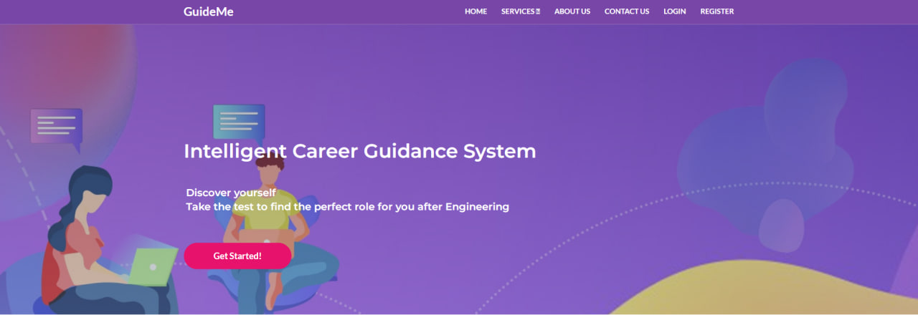
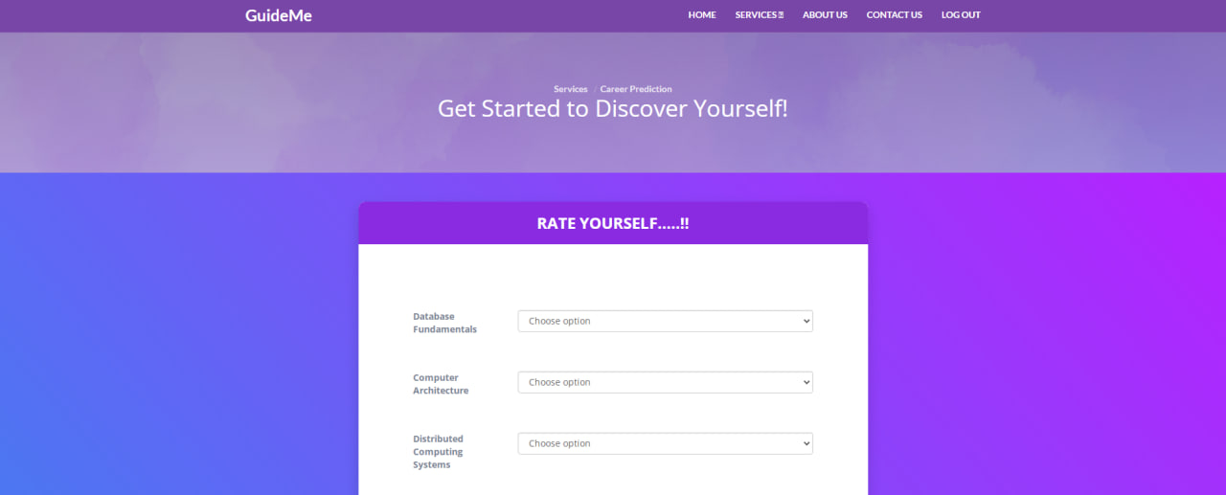
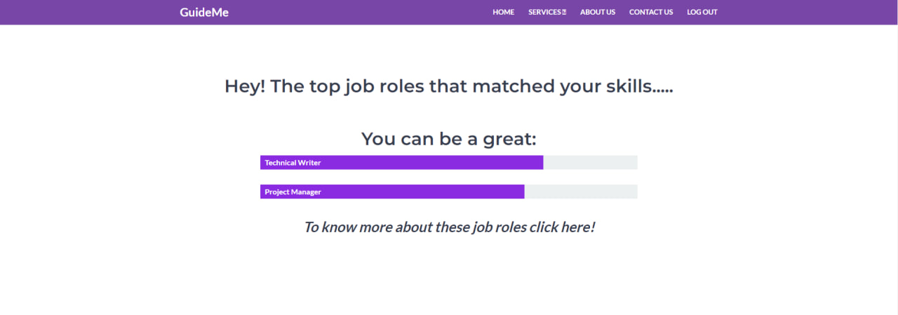
GUIDEME –
Aeshna Jain
Acropolis Institute of Technology and Research
INTRODUCTION
FEATURES
TECHNOLOGY USED
CONCLUSION
Career choice has a pivotal role in college students’ life planning. In today’s world choosing the right career is the toughest decision. Today many students are confused about their future. They do possess some skills, but they are not able to identify their abilities and a proper domain. Different people suggest different career options but at last, the student must select their career. In this project, we have focused on this problem of the student using machine learning. With the help of machine learning, we will help the student to decide which is the best career option and domain for them using different machine learning techniques. The career is decided based on academic information filled by the student. This project will help the student to get directed towards a specific domain as per their skills.
User friendly environment :
Simplified fields:
FLASK : Flask is a micro web framework written in Python. It is classified as a microframework because it does not require particular tools or libraries. It has no database abstraction layer, form validation, or any other components.
PYTHON : Python is a high-level, general-purpose programming language.
HTML5 :HTML5 is a markup language used for structuring and presenting content on the World Wide Web.
CSS 3 : CSS describes how elements should be rendered on screen, on paper, in speech, or on other media.
Bootstrap : Bootstrap is a free and open-source CSS framework directed at responsive, mobile-first front-end web development.
In conclusion, the career guidance project will provide valuable insights and resources for individuals looking to explore and pursue their career aspirations. Through the research and analysis conducted, we have highlighted various career paths and industries, as well as the skills and qualifications needed to succeed in them. We have also discussed the importance of networking, internships, and continued education in the job search process. By utilizing the information provided in this project, individuals can make informed decisions about their career goals and take steps towards achieving them. We hope that this project has been helpful in providing guidance and inspiration for individuals as they navigate their career journey.
CONTACT
OBJECTIVES
ATHARV SHARMA
atharvsharma20327@acropolis.in
BHAVIK SHARMA
bhaviksharma20111@acropolis.in
ARCHIKA KASLIWAL
archikakasliwal20220@acropolis.in
APOORVA SHRIVASTAVA
apoorvashrivastava20893@acropolis.in
Enhance understanding of their personality types
Educate on the various options
Enable them for their career planning, development, and guidance.
Enable them for their career planning, development, and guidance.
Assist from choosing wrong options.
Be a partner in the overall journey.
FUTURE SCOPE
Accurate results:
Future work for the "Guideme" project could include integration with additional data sources, expansion to other fields, refinement of machine learning algorithms, integration with career development resources, and ongoing user feedback and testing. These improvements could enhance the accuracy, relevance, and usefulness of the system's recommendations, and ensure that it continues to meet the evolving needs of students and other users.
REFERENCE
https://flask.palletsprojects.com/en/2.2.x/
https://scholarships.gov.in/
https://www.scholarships.com/
https://getbootstrap.com/

